Slide 1


Updated: May 2022

Slide 2
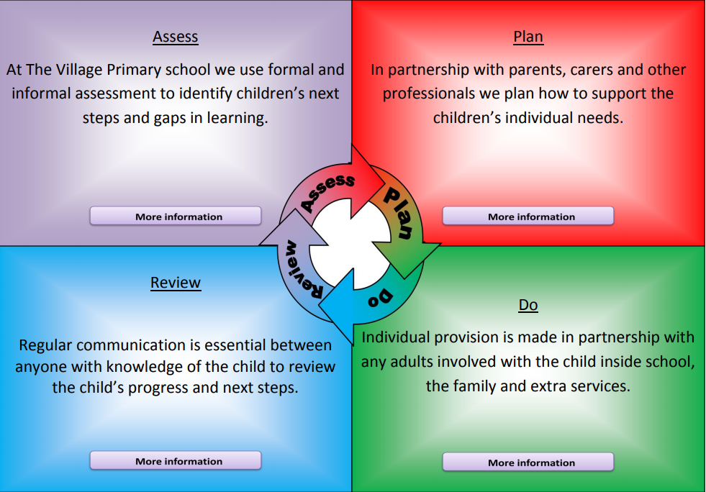

Slide 3
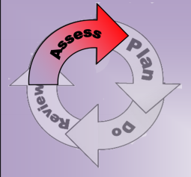
At Village Primary school we strive to provide quality first teaching with differentiation for all children whatever their ability. This provision includes:
Consistency and continuity of expectations throughout school.
Classrooms that are well organised, labelled and resources to support learning accessible.
A range of high quality, multisensory resources to support children and their learning.
Reflective teachers, who plan, deliver, review and assess well differentiated lessons that cater for a variety of learning styles.
Teaching assistants, that under teacher’s guidance support whole class teacher, group work or deliver differentiated activities.
A range of CPD (continuous professional development i.e. training) opportunities for all staff to ensure all adults working with children have up-to-date knowledge, training and relevant qualifications for the presenting needs in school.
Where appropriate, children will be involved in all discussion relating to decisions around their learning and needs.

Slide 4
Through our school assessment it may be identified that a child with SEND may need adapted arrangements when it comes to formal assessments such KS2 SAT’s i.e. extra time.
If this applies to your child this will be discussed with you at the beginning of the relevant year.
Should you find you feel your child’s SEND issues are not being dealt with in a way you deem appropriate, after speaking to Miss Begley and Mr Birtwhistle, you have every right to make a complaint.
These concerns can be sent to the Schools chair of Governor Mrs J. Hughes care of (c/o) The Village Primary School.
Stockton has a service called SENDIASS that offer independent advice and support to parents/carers of children with SEND.
A copy of the schools SEND policy can be found on the schools website.
A link to what Stockton local authority offer SEND children and families (The Local Offer) can be found here.

Slide 5
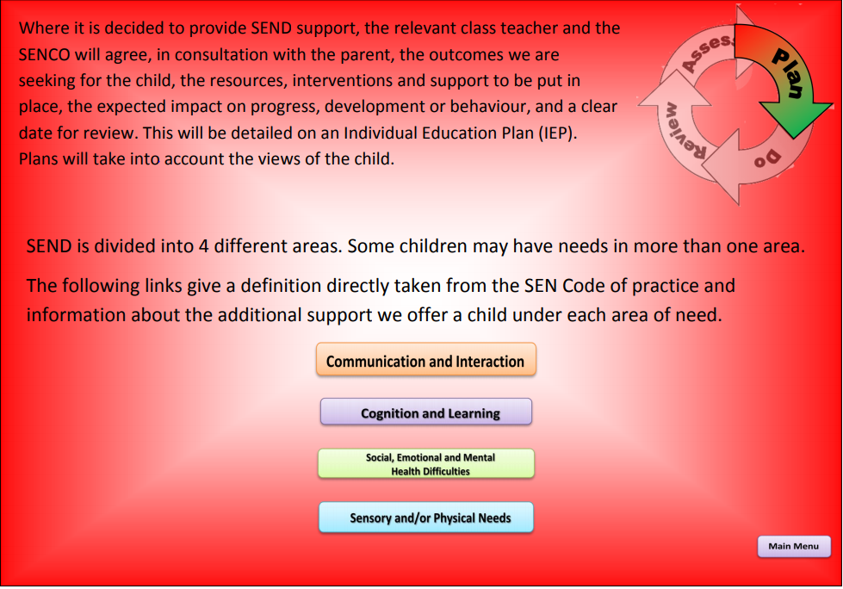

Slide 6
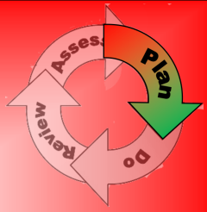
Communication and Interaction
“Children with speech, language and communication needs have difficulty in communicating with others. This may be because they have difficulty saying what they want, understanding what is being said to them or they do not understand or use social rules of communication.”
To support these children in school we use:
• Increased visual aids / modelling etc
• Visual timetables
• Use of symbols
• Use of PECS in classroom
• TEACCH approach
• Small social skills and/or friendship group
• Additional TA support at play and lunch times
• Additional buddy support at playtimes and lunch times
• Access to ‘walk and talk’/ ‘drink and a think’ strategy
• Access to speaking and listening skills intervention
• Paired or 1:1 curriculum tasks with differentiated support
• Individual work station and individual visual timetable
• Specific interest clubs
• Social Stories
• Regular, short sensory breaks
• High Level of TA support
• Personalised small group learning
• Flexible groupings with access to positive peer speech and language models
• Visual prompt cards e.g. turn taking or stay on topic
• Feelings Check in
• Interventions based upon class-based learning delivered by TA

Slide 7
Cognition and Learning
“Cognition and learning means a child learns at a slower pace than their peers, even with appropriate differentiation. This may be due to a specific issue such as dyslexia, dyscalculia or dyspraxia.”
To support children in school we use:
Learning presented in small chunks. Mini plenaries throughout session to ensure pupils making good progress.
Intervention given to overcome misconceptions including follow up and follow on work from whole class learning
Small group work. Routine opportunities for over-learning
Emphasis on skill mastery
Significant emphasis on consolidation before moving forwards
Personalised provision targets using Assess, Plan, Do, Review framework
Visual timetables
Access to ICT to help reduce barriers to learning
Alternative forms of recording sometimes used
Active learning lessons
Daily 1:1 reading
Toe by Toe intervention
Phonics intervention groups
Write From The Start intervention to support handwriting,
Listening Skills intervention
Teaching memory strategies
Additional time for key curriculum areas
Access arrangements for tests and exams
Coloured resources e.g. paper, overlays for reading
Reading rulers and Number lines
Numicon
Coloured overlays
High Level of TA support
Practical maths equipment

Slide 8
Social, Emotional and Mental Health
“Children and young people may experience a wide range of social and emotional difficulties which show themselves in many ways. These behaviours may reflect underlying mental health difficulties such as anxiety or depression, eating disorders or physical symptoms that are medically unexplained. Other children and young people may have disorders such as attention deficit disorder, attention deficit hyperactive disorder or attachment disorder.”
To support children in school we use:
Positive staff relationships and links so that children have a key person to talk to who is familiar with the issues around the child.
Circle time/PSHCE opportunities in each classroom.
A Parent Support Advisor (PSA), Mr Dixon, who works with children and families to address some issues that may impact on a child such as attendance.
The PSA works alongside Attendance Welfare if a child’s attendance drops below an acceptable level and may look at solutions to correct this.
The SENDCO has regular contact with a children and adolescents mental health worker (CAMH’s) who can identify further assessment, work and support that can be provided for staff of children and families to support needs.
Referrals can also be made to Alliance, Harbour, the behaviour improvement team and Forget Me Not for access to other services for differing issues such as bereavement councilling.

Slide 9
Sensory and Physical
“Children and young people with a visual impairment (VI) or a hearing impairment (HI) may require specialist support and equipment to access their learning. Children and young people with a Multi-Sensory Impairment (MSI) have a combination of visual and hearing difficulties, which makes it much more difficult for them to access the curriculum or study programme than those with a single sensory impairment. Some children and young people with a physical disability (PD) require additional on-going support and equipment to access all the opportunities available to their peers.”
To support children in school we use:
The school building is fully accessible for children who have physical needs i.e. a wheelchair as we have ramps, no steps and wheel chair accessible toilets with relevant adaptions.
Village Primary School is fully inclusive and reflective school. Should a pupil with additional sensory and/or physical needs be welcomed into our school community strong relationships would be built and advice sought from specialists i.e. occupational therapists, physiotherapists etc.
We would also strive to adapt the curriculum to enable full access e.g. alternative recording devices, modified curriculum.

Slide 10
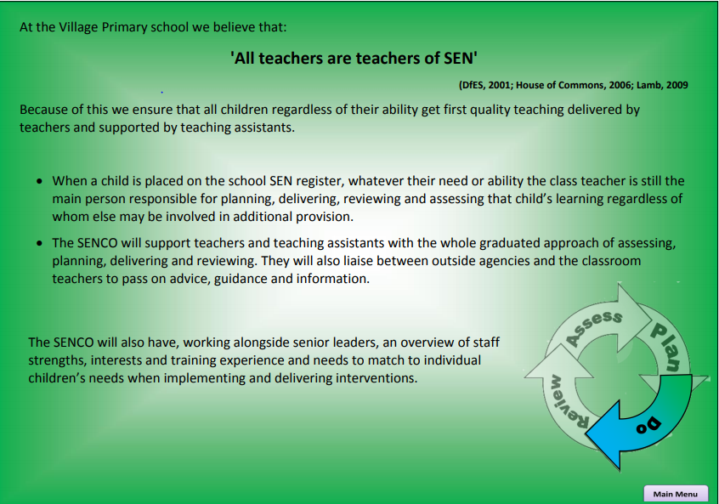

Slide 11
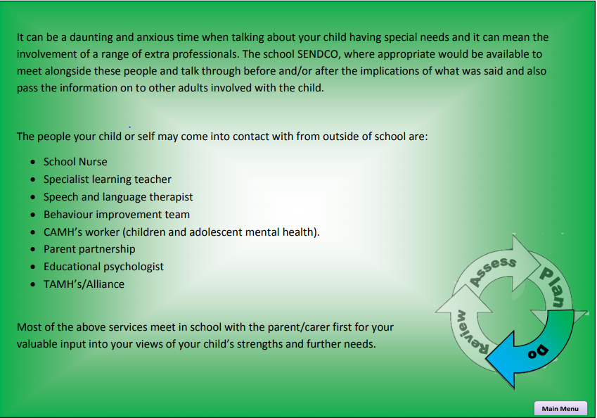

Slide 12

As parents you will be kept informed, by your child’s class teacher or the SENDCO, of what is going on in school in the following different ways:
Face to face conversations
Phone calls
Meetings to review and share IEP’s.
Parents meeting
And any other meeting that may be held to update of discuss your child
If your child has an Education Health Care plan (previously called a Statement of Special Needs) there is an annual review that will be held.
You are always welcome to arrange a meeting with your child’s classroom teacher or the SENCO Miss Begley. The best way to do this is ring the school on 01642 676768 to arrange a mutually agreeable time for yourself and the member of staff you wish to speak to.
Potentially there could be several people working with your child at any one time. To keep track of all the major communication any meeting, phone call or report about your child is kept in their own individual SEN file and each file has a communication log which allows The SENCO to keep up to date with the most current information.

Slide 13
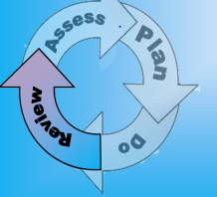
The staff at Village Primary School are reflective and proactive professionals who review learning on often a lesson by lesson basis. Children with SEN need small, achievable targets to ensure they feel successful.
The active reviewing of targets and learning can be seen in:
The marking of children’s work in books
Children are encouraged to reflect and respond to the marking and therefore become involved in their progress.
IEP’s are regularly annotated by all staff working with that child to ensure that things that are working, as well as areas of concern are noted for all to see.
The majority of the interventions have a clear entry and exit criteria and so progress is measurable at the end of the intervention.
Senior leaders require an update of children’s levels every term which will draw on IEP’s and the intervention data so in effect children’s learning is being reviewed every term.
Where required this will lead to adaption’s or amendments to the provision being provided to individual children and again will be noted on the child’s IEP.
The IEP’s will then be reviewed and updated each term by the class teacher and in conjunction with the SENCO, child and parent/carer.
At the end of each school year your child will receive a school report identifying things they have achieved and the next steps in their learning

